Slide 1
Al-Anon Family Groups Copyright & Trademark Protection
Understanding the new world reality and how members can help protect Al-Anon’s name
Notes:
Just a few short years ago, copyright and trademark challenges were not something that needed to be understood by a regular Al-Anon member. Al-Anon Family Group Headquarters, Inc. managed these legal rights, offering by informal, undocumented agreement the right to use the Al-Anon name and logo to every Al-Anon Family Group and service arm. Groups and service arms were understood to have trusted servants familiar with the “Digest of Al-Anon and Alateen Policies” section of the Al-Anon/Alateen Service Manual, who would share their knowledge to ensure obedience to the unenforceable, even the relatively technical section on “Conference Approved Literature and Service Tools/Materials.”
Then, slowly but steadily, the internet came to the forefront of our recovery program experience. Members began creating Facebook groups to meet, separate entities disconnected from the Al-Anon service structure began creating websites, and members began posting YouTube videos to share the Al-Anon message. On the whole, the members building these new means of reaching those still suffering from the family disease of alcoholism were operating in what they understood to be the best interests of Al-Anon as a whole. They did not understand that use of the Al-Anon trademark and posting of copyrighted materials diluted AFG, Inc.’s ability to protect our name from sources in the future who might not be operating with good will and intentions.
Over the last several years, the onslaught of violations and members requests for information led the WSO to create a part-time Legal Assistant position. Anne P. currently serves in this position, informing members, writing letters to those who post violations, and, thankfully, enjoying many positive responses from those members who, once educated about copyright and trademark, promptly corrected their website and group procedures. The consistency in the nature of the violations led Anne to suggest we create a presentation for the World Service Conference members to help share information about what does and doesn’t violate Al-Anon’s copyright and trademark in the hopes of expanding the WSO and WSC Structures’ capacity to inform and reduce the incidence of violations.

Slide 2
COPYRIGHT
What: The exclusive legal right given to an originator to print, publish, perform, film or record a piece of work
Why: Protects the collective wisdom of Al-Anon members
How: Ensuring only the entity which owns the rights can legally use it
When: All the time
Notes:
The “World Service Handbook” section of the 2022-2025 Al-Anon/Alateen Service Manual (P-24/25) v2 on page 150 states, “The group conscience of Al-Anon can work effectively only if it is informed.” Likewise, the WSO recognizes that Al-Anon members, groups, and the links of service can only operate successfully in protecting Al-Anon Family Groups' trademarks and copyrights when they are informed.
So, let’s start by explaining the legal concept of “copyright”:
What is copyright? It is “the exclusive legal right, given to an originator or an assignee, to print, publish, perform, film, or record literary, artistic, or musical material, and to authorize others to do the same.” Say again?! In English and in terms of our fellowship, what this statement means is that Al-Anon Family Group Headquarters, Inc. is the only organization that has the legal right to print and publish Conference Approved Literature and to give permission to others to do the same.
Why is that important? It’s important because Al-Anon’s Conference Approved Literature (CAL) represents the collective wisdom of our fellowship. Most members know how invaluable that wisdom can be in our daily lives. We rely on it to ground us during our daily prayer and meditation practices, whatever those might look like, and to guide us when we turn to CAL in our times of need. So, having the legal right and ability to protect our CAL and other published materials is the only means of protecting that wisdom. It provides us the ability to ensure a consistent Al-Anon message can be heard at every Al-Anon Family Groups meeting, thus protecting Al-Anon as a whole.
And how do we do this? We do this by ensuring that “only the entity who owns the intellectual property can legally use it or permit others to use it.” In other words, we do that by ensuring that any member, group, or service arm that wishes to print or publish online an excerpt of our literature first gains permission to do so from Al-Anon Family Group Headquarters, Inc., which is often referred to within the fellowship as the World Service Office or WSO. You’ll hear about how the WSO extends this permission to groups and the links of service later in the presentation.
You may be wondering when copyright needs to be protected. And the answer, as you probably guessed, is all the time. To be successful in defending its copyright, the WSO needs to be able to demonstrate that it seeks to protect its rights consistently and diligently, which gets to be a pretty daunting task when you look at the worldwide scope of the Al-Anon program and service structure. This is why the WSO needs your help!

Slide 3
TRADEMARKS
Al-Anon “marks” registered with the U.S. Patent and Trademark Office (and global equivalents)
Names:
AL-ANON
ALATEEN
Symbols and Logos
Notes:
Before moving on to how members can help, it may be helpful to explain another important legal concept: trademark. Many Al-Anon members don’t know that even the names “Al-Anon” and “Alateen” are registered “marks” of Al-Anon Family Group Headquarters, Inc. Using the names Al-Anon or Alateen without permission therefore violates copyright law. The same is true for Al-Anon symbols and logos. And this applies whether usage is within the United States, Canada, Bermuda, or anywhere else around the world.
Legally, this means that every member, group, and service arm needs to request permission to use the Al-Anon name before doing so. We’ll talk more about how the WSO manages the enormity of this task, and how you can help, later in this presentation. For now, it is helpful simply for you to understand the scope of Al-Anon’s trademark and copyright efforts.

Slide 4
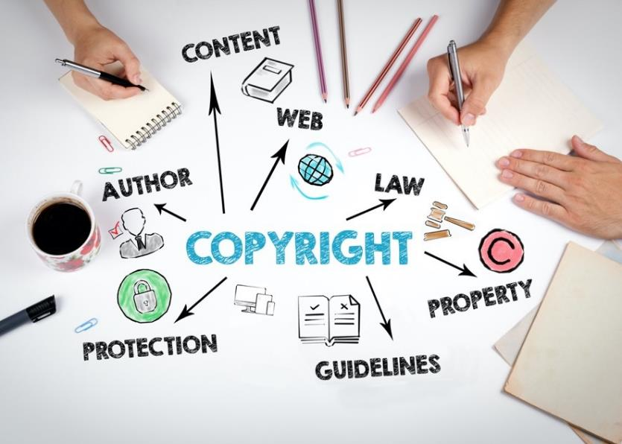
Violating Copyright Harms Al-Anon
Notes:
You may be asking yourself, “What are the ways in which disrespecting copyright can harm Al-Anon? Are the impacts only legal?” The answer is that, in fact, there are several traditional implications to violating copyright as well as harm that extends beyond just the obvious.
If a trademarked Al-Anon name or logo is used by those associated with outside interests, such as events not linked to the service structure, this use can violate Tradition Ten by implying outside affiliation and, potentially, inadvertently drawing Al-Anon into public controversy.
When members or groups create social media content that includes the Al-Anon name or symbols, they can give the appearance of acting on behalf of Al-Anon as a whole. This violates Tradition Four, affecting Al-Anon as a whole by connecting our program to an individual or organization and, in the case of social media, our principle of anonymity described in Tradition Twelve if an individual’s membership is revealed.
Violations of copyright costs Al-Anon resources, both human and financial, as the WSO and other service structures around the world must work to protect our copyright. Whenever a violation of copyright comes to the attention of the Board of Trustees, it is the responsibility of the Board, through its duly appointed representative, to notify the violator. This is necessary in order to avoid invalidation of the copyright. This effort diverts the WSO Staff and trusted servants from our primary purpose.

Slide 5
Violating Copyright Harms Al-Anon
Notes:
Also…
The consistency of the Al-Anon message and program can be harmed when Al-Anon’s copyrighted materials are reproduced incorrectly, which happens frequently, albeit unintentionally, if members copy and paste from or retype copyrighted CAL incorrectly.
On a larger scale, Al-Anon can be harmed financially by unauthorized third-party entities reproducing and selling CAL without permission.

Slide 6
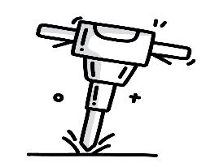
Common Violations of Copyright
Reproducing Conference Approved Literature
Using the Al-Anon Logo or Name on Social Media Pages or Websites
Modifying the Al-Anon or Alateen Logo
Notes:
Now that you understand some of the impacts of violating copyright, you likely want to know what the most common violations of copyright are so you can inform members in your Areas, District, groups, and international structures about what to avoid.
One of the most common violations reported to the WSO is the unauthorized reproduction of CAL both on the internet and beyond, including:
Posting the content of CAL on the internet. For example, groups meeting electronically may want to ensure everyone attending is able to read the daily reading being shared during the meeting. Some service arms will post CAL or service tools in full on their pages to attract newcomers.
Photocopying or scanning CAL. An example of this occurs when a member innocently copies pages of CAL to use at their home group when they lead a meeting.
Unauthorized production and sale of CAL. Some individual or organization, in fact, has done this with the daily reader, One Day at a Time in Al-Anon (B-16), by posting an ebook for sale on Amazon.
Retyping CAL.
Another common violation is the use of Al-Anon or Alateen logos or the Al-Anon or Alateen name on social media pages and websites when announcing a service or fellowship recovery event.
Less frequent, but still relatively common, is the alteration or modification of the Al-Anon or Alateen logo in any way. Typically, we see this when conventions or other entities not linked to the service arm create their own version of the Al-Anon logo, often including a design or words in the logo to represent their unique event.
Of course, while these actions generally do represent violations, in keeping with Al-Anon’s primary purpose of sharing the message of hope with those still suffering from the family disease, there are some unusual circumstances when these actions may be permitted by the WSO.

Slide 7
Permission to Use
Traditional
Explicit
Al-Anon name & logo
Group and registered service arm event flyers
Registered service arm websites and social media pages
Al-Anon Guidelines
Photocopies created by members, groups, and service arms
Excerpts from CAL
Members, groups, and registered service arms may reprint limited excerpts with approval.
CAL in meetings
Groups may photocopy or post CAL readings for the duration of the meeting only.
Notes:
Recognizing the need to attract members to our meetings and groups in order to fulfill Al-Anon’s primary purpose, some traditional permission is granted to Al-Anon Family Groups and their registered service arms. For example,
Groups may use the Al-Anon or Alateen logo on group event flyers.
WSC Structure service arms, which consist of Areas, Districts, Al-Anon Information Services, and Intergroups, may use the Al-Anon or Alateen logo or the Al-Anon or Alateen name on:
Social media pages
Websites
Guidelines
Additionally, all registered Service Arms, groups, and members may download, print, photocopy, and publish Al-Anon Guidelines, as these represent the experience, strength, and hope of our members and groups in undertaking Al-Anon service responsibilities.
The WSO also offers explicit permission in certain cases to use trademarked and copyrighted materials:
The WSO provides permission to those members, groups, and registered service arms which request permission to reprint limited excerpts of Conference Approved Literature using the reprint permission form available on al-anon.org.
In the last few years, the WSO has rolled out new group registration and update forms that include explicit permission to use CAL during meetings. This permission applies to both in-person and electronic groups. It allows for the printing or posting of only the portion of CAL feasible to be shared and discussed during one meeting. When registering, groups agree not to permanently post materials but instead to remove them immediately following the meeting, in the case of a post; or ask members to return the material for shredding at the end of the meeting, in the case of photocopies. (Specifics can be found by reviewing the New Al‑Anon Group Registration Form available on al-anon.org)
[Note for presenter only in case of questions]
New Al‑Anon Group Registration Form:
“By registering as an Al‑Anon Family Group with Al‑Anon Family Group Headquarters, Inc. (AFG, Inc.), a group is granted permission to use the Al‑Anon trademarked name and logo without modification for the purposes of Public Outreach as well as AFG, Inc. copyrighted materials for the sole purpose of conducting its meetings. Al‑Anon copyrighted materials are limited to:
Suggested Welcome, Suggested Closing, Suggested Preambles to the Twelve Steps, the Twelve Steps, Twelve Traditions, and Twelve Concepts of Service as they are found in the current version of the Al‑Anon/Alateen Service Manual (P‑24/27), without alteration or modification.
Conference Approved Literature (CAL) screenshots or printouts, when accompanied by copyright acknowledgment and limited in scope to content possible to be shared and discussed during one meeting.
This permission is granted for as long as the group continues to hold meetings; remains in compliance with AFG, Inc. intellectual property policies and instructions; refrains from distributing or posting permanently, in a public forum, copyrighted materials; and remains an Active registered group with AFG, Inc. These materials may not be modified and permission to use these materials may not be transferred to anyone without prior written approval. The group shall not use the materials in any way that could damage the reputation and goodwill that has been established in the material."

Slide 8
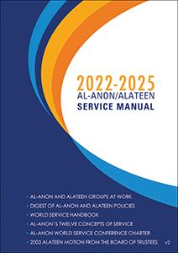
Resources
Notes:
Well, that was a lot of information in a very short period of time. Members may find other WSO resources helpful when seeking guidance in determining whether a certain action is a copyright or trademark violation.
The 2022-2025 Al-Anon/Alateen Service Manual (P-24/27) v2 includes, as part of the “Digest of Al-Anon and Alateen Policies,” information on:
Copyrights (page 116)
Logos/Symbols (page 117)
Authorization to Publish and Reprint (page 117)
Social Media (pages 127-128)
The pamphlet Why Conference Approved Literature? (P-35) includes a “Respecting Copyrights” section on page five.
Page two of the Al-Anon Guideline Al-Anon Service Arm Websites (G-40) contains a list under the heading “Some content is not suitable for posting on service arm websites,” which outlines specific copyright violations.
Members may also be interested in viewing the “Protect Al-Anon’s Name” section of the 2021 World Service Office Annual Report, available on pages 103-104 of the 2022 World Service Conference Summary (P-46).

Slide 9
Thank you for your efforts to share this message and protect Al-Anon’s trademark name and copyrights!
Notes:
The descriptive text of Concept Twelve, Warranty Four states:
“It has been said, ‘Al‑Anon is prepared to give away its knowledge and experience—all except the Al‑Anon name itself.’ Our principles can be applied in any situation. We do not wish to monopolize them. We simply request that the public use of the Al‑Anon name be avoided by those who wish to avail themselves of Al‑Anon techniques and ideas. In case the Al‑Anon name should be misapplied, it would of course be the duty of our World Service Conference to press for the discontinuance of such a practice—avoiding, however, public quarreling about the matter.”
We appreciate your willingness today to increase your understanding of how Al-Anon can protect its trademark, name, and copyrighted materials, and we look forward to hearing how you have shared this message with your groups and local service arms.
We will now take a few questions.

