Slide 1
Alateen Electronic Group Feasibility – Members Strategy
2023 World Service Conference
Notes:
SARAH:
Good morning, World Service Conference. Sarah Smith, WSO Staff. As the Chair of this Strategy project, it’s a privilege to present the continuation of our work to you this morning. Since the World Service Conference is here in Virginia Beach, we are fortunate that we have the members of the Project Team joining us this morning as guests:
Sarah Smith – Director of Programs
Sue Perez – Associate Director, Group Services
Christa Abildgaard – Senior Group Services Specialist
Tracey Smith – Group Services Specialist
Anne Peacock – International & Legal Specialist
Valerie Stump – AFG Records Manager
Tanya Jisa – Associate Director, International
Today, we will start by reviewing part of the presentation we shared with the 2022 World Service Conference. This part of the presentation identifies the origin of this conversation as well as what we worked to complete over the past year, which ultimately led to identification of the conceptual process we shared with you on AFG Connects to allow electronic Alateen meetings to become Al-Anon Family Groups.
You may notice there is a train theme throughout the presentation. This theme was chosen to highlight how the evolution of electronic Alateen meetings being recognized as Al-Anon Family Groups has become a long journey with many stops along the way. Last year at 2022 World Service Conference, we ended our presentation with a stop at a “refueling station.” At this stop, we shared with you that we were going to explore many unanswered questions regarding the possibility of creating a process to accept electronic Alateen meetings as Al-Anon Family Groups. The Project Team has been hard at work the last year and we are ready to continue the next leg of our journey.
So, let’s get started as we review how it all started; make a stop to review what we knew when we stopped at the refueling station in 2022; and then carry on to introduce the proposed conceptual process, conduct a Q&A session and additional discussion, and highlight the next steps of the process.
<CLICK>

Slide 2
The Origin: AFG, Inc. Strategic Plan Strategy
Scope – Evaluate the implications of and gain agreement on a cohesive approach for expanding online Alateen meetings (not including Alateen events availability) through the Al-Anon Family Groups Mobile App and potentially other platforms.
Anticipated Outcome – Make online platform(s) available for all Alateen members who wish to participate while ensuring the safety of Alateen and AMIAS members.
Notes:
SARAH:
The origin of the entire train ride was the AFG, Inc. Board of Trustee’s Strategic Plan Alateen Electronic Group Feasibility Strategy, so let’s start with understanding that Strategy’s Scope and Anticipated Outcome:
The Scope – Evaluate the implications of and gain agreement on a cohesive approach for expanding online Alateen meetings (not including Alateen events) availability through the Al-Anon Family Groups Mobile App and potentially other platforms.
The Anticipated Outcome – Make online platform(s) available for all Alateen members who wish to participate while ensuring the safety of Alateen and Al-Anon Members Involved in Alateen Service members.
Between 2021 and 2022, the Project Team effort toward that anticipated outcome brought us to the 2022 World Service Conference “refueling station” stop, where the team deboarded to gather answers to important outstanding questions and highlight the work ahead.
<CLICK>

Slide 3


First Stop: The 2022 WSC Refueling Station
Notes:
SARAH:
Here’s what the Project Team shared at the 2022 WSC “Refueling Station”:
<CLICK SOUND EFFECT AND LET PLAY>
Whew! We have arrived at the station.
Check your itinerary. If your destination is electronic Alateen groups, stay on this train. We will be leaving shortly to explore what’s next in the process. This leg of the journey is all about exploration! Similarly, in the Knowledge Based Decision Making process, we ask, “What do we wish we know, but don’t?” in conjunction with the other four questions outlined in the process.
A few more minutes and we will fire the engine up. Let’s think about the following:
Physical Alateen meetings vs. electronic Alateen meetings – What are our current realities?
What are the legal implications related to hosting electronic Alateen meetings safely?
Are the minimum requirements from the 2003 Alateen Motion from the Board of Trustees sufficient for ensuring the safety of Alateens and Al-Anon Members Involved in Alateen Service participating in electronic meetings?
As always, there is hard work ahead! Let’s review what is next.
<CLICK>

Slide 4

What are physical vs. electronic meeting current realities?
Physical Meetings | Mobile App Meetings
Area Alateen Safety & Behavior Requirements Defined by Areas | Area Alateen Safety & Behavioral Requirements Supported & administered by WSO Hosted by Areas
Notes:
SUE:
A key question to answer before reboarding related to the operational / execution elements of administering and supporting electronic Alateen meetings to run safely. As the WSO has attempted to do consistently throughout the development of procedures and policy related to electronic Al-Anon groups, we started by evaluating the similarities and differences between groups meeting physically and those meeting electronically.
Since the Project Team knew our own structure best, we started by evaluating our WSC Structure physical and electronic Alateen meeting processes.
Within the WSC Structure, physical Alateen meetings are supported by processes created by Areas, guided by the 2003 Alateen Motion from the Board of Trustees, the Alateen policy, and local legal requirements. Each Area has its own process to train and certify Al-Anon Members Involved in Alateen Service and to determine how many certified Al-Anon Members Involved in Alateen Service are required to be in attendance in order for the Alateen group to hold its meeting. These unique processes and requirements are captured in each Area’s Alateen Safety & Behavioral Requirements.
The only electronic Alateen meetings in the WSC Structure are the six Al-Anon Family Groups Mobile App electronic Alateen meeting pilots. The Mobile App meetings are hosted by certified Al-Anon Members Involved in Alateen Service from Areas in the World Service Conference Structure, and one meeting is hosted by Poland, which trains their Al-Anon Members Involved in Alateen Service in accordance with the 2003 Alateen Motion and their local processes. Unlike with the physical meetings, WSO Staff provide training sessions and host quarterly meetings for the Al-Anon Members Involved In Alateen Service supporting these meetings. The WSO also requires a minimum of two Al-Anon Members Involved in Alateen Service be present to host the electronic Alateen meetings held on this platform, although three are recommended to ensure Alateen safety given the complexities of the Mobile App platform and navigation.
Last year we introduced the international structure pilot projects. These pilot projects introduced a new perspective on how electronic Alateen meetings might be overseen as its exploration continued into realm of legal implications.
<CLICK>

Slide 5
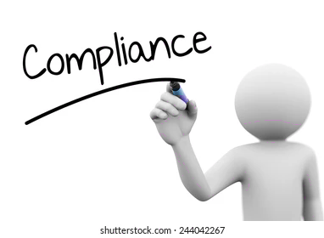
What are the legal implications?
  US does not have a federal safety requirement for minors meeting in person.
  US has a minimum age limit for businesses engaging with minors through electronic media.
Notes:
SUE:
As in its efforts to explore the question about current realities, the Project Team began its research into legal implications by reflecting on what we knew about our own WSC Structure.
We knew from experience that laws related to minors vary significantly within our Structure. Not only do they vary between the three countries within the WSC Structure but even between jurisdictions within these countries. Our International & Legal Specialist consulted with AFG, Inc. legal counsel to understand WSO’s overall legal responsibility as it pertains to minors participating on electronic formats according to current legislation. We discovered that although the United States does not currently have a federal safety requirement for laws regarding interacting with minors on the internet, its Children's Online Privacy Protection Act (referred to as "COPPA") establishes a minimum age limit of 13 years old for businesses engaging with minors through electronic media. Our counsel also alerted us that the United States Congress is currently proposing an update to the Children's Online Privacy Protection Act law that would increase the minimum age from 13 to 16 years.
As we sought insights from the broader international community, we discovered national laws related to minors were more typical and they tended to be more stringent than our own.
With the goal of finding answers that would allow Al-Anon Family Group Headquarters, Inc. and Al-Anon’s national structure legal entities to abide by the law, the Project Team continued our exploration of the last “refueling station” question before reboarding.
<CLICK>

Slide 6
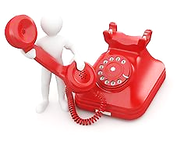
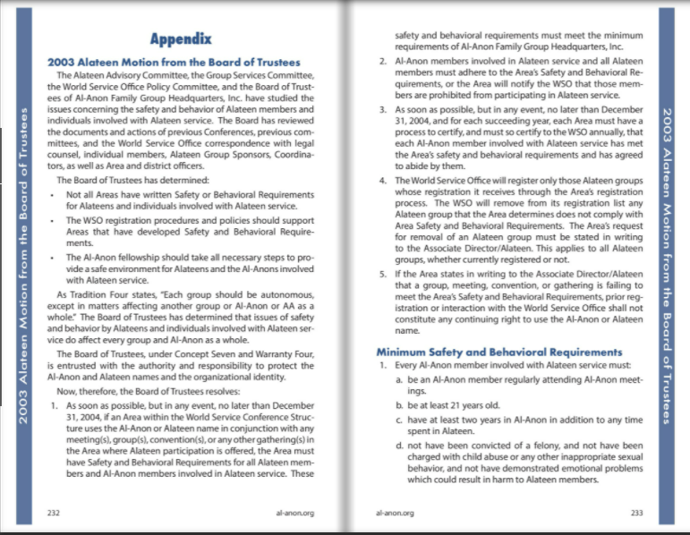


What requirements might be necessary?
MORE STRINGENT
MORE STRINGENT
Notes:
SUE:
The convergence of insights gained from the Project Team’s first two explorations placed us in a good position to explore the third question from the refueling station, which is:
Are the minimum requirements from the 2003 Alateen Motion from the Board of Trustees sufficient for ensuring the safety of Alateens and Al-Anon Members Involved in Alateen Service participating in electronic meetings?
In addition, the Team realized it was necessary to evaluate another question in parallel, as it relates directly to the feasibility of global acceptance of higher minimums:
How stringent can the minimum requirements be to support Alateen safety while encouraging adoption?
In order to do so, the Project Team requested help from you! We identified 20 Areas within the WSC Structure that had the most stringent requirements. We reached out to a subset of these Areas to gather additional information that may not have originally been provided in the Alateen Safety and Behavioral Requirements review, such as required criminal background checks, mandated reporting, additional training, etc. Thank you to all Areas who answered the request and provided information.
We also reached out to our international partners who were conducting trials of electronic Alateen meetings. We invited their insights and experiences through a series of questions similar to what was asked of WSC Area trusted servants. This led us to recognize that legal requirements globally were much more stringent than even the most stringent Area within the WSC Structure. While mandatory reporting was a consistent theme within the WSC Structure Areas, international structure minimums, for instance, included parental consent for all participation by minors in an electronic meeting.
Armed with insights, the Project Team realized it was time to reboard the train and move forward towards development of a conceptual solution for discussion and consideration.
<CLICK>

Slide 7
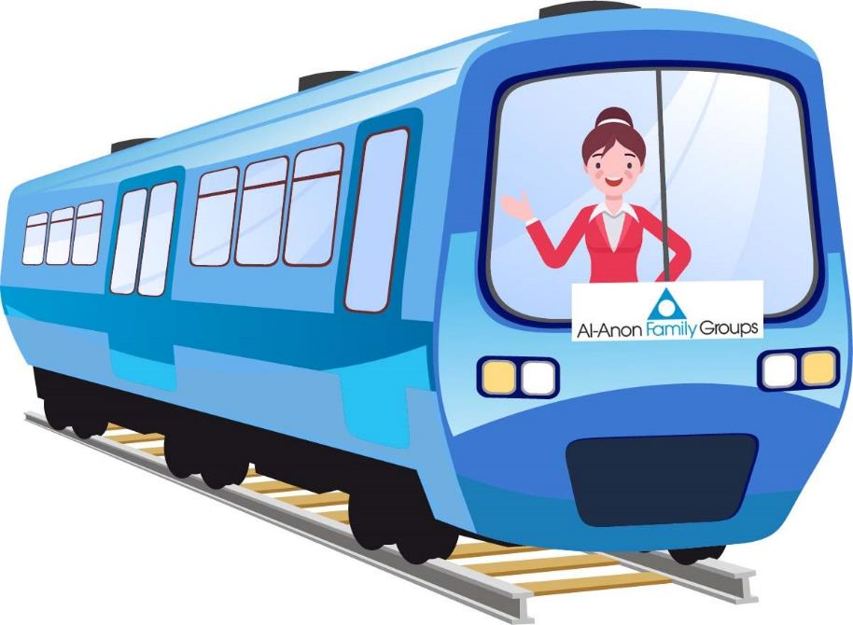
Engineering a Solution: Electronic Alateen Groups
Notes:
SUE:
In the Al-Anon/Alateen Service Manual (P/24-27) on page 202 under the Concept Nine descriptive text, Bill Wilson stated in his essay on leadership, “Vision is, I think, the ability to make good estimates, both for the immediate and more distant future.”
Thanks to your willingness to answer our calls for help and to share your experience, strength, hope, and feedback, the Project Team has now completed its first “good estimate” of a vision for answering the Board of Trustees charge of making online platform(s) available for all Alateen members who wish to participate while ensuring the safety of Alateen and Al-Anon Members Involved in Alateen Service.
Are you ready to hear more? To continue the journey? I hear the train coming! Let’s go! All aboard!
<CLICK for train noise>
<CLICK>

Slide 8

Vision: Conceptual Process for Electronic Alateen Groups
Notes:
SARAH:
Wouldn’t it be great if there was a process that would allow Areas and international structures to decide if they would like to host electronic Alateen groups while ensuring the safety of minors? The conceptual solution that emerged represents a set of minimum safety requirements the Project Team believes could be appropriate for the global nature of the electronic meetings involving minors. We came to refer to these as the Global Electronic Alateen Safety and Behavioral Requirements (Global Electronic Alateen Safety and Behavioral Requirements). The Project Team believes these could work for Areas within the WSC Structure as well as international structures. This Global Electronic Alateen Safety and Behavioral Requirements will establish a minimum standard for Al-Anon Members Involved in Alateen Service Electronic (AMIAS-E) no matter where they reside in the world. Prior to this meeting you received a copy of the conceptual process.
Let’s continue the journey. Together, in the next few slides, we will walk through this conceptual solution, which includes:
Global Electronic Alateen Safety and Behavioral Requirements and Minimums
Global Alateen Meeting Management Minimums
<CLICK>

Slide 9

Benefits: Global Electronic Alateen Safety and Behavioral Requirements (EASBR)
Electronic Alateen groups are recognized as Al-Anon Family Groups
Service structures globally enjoy autonomy of choice as to whether to host electronic Alateen groups
Electronic Alateen groups can connect to their service structure with voice and vote
Notes:
SARAH:
First, let’s review some benefits of the Global Electronic Alateen Safety and Behavioral Requirements:
Alateen groups meeting electronically (Electronic Alateen Groups) could be recognized as Al-Anon Family Groups.
Electronic Alateen groups could be connected to their service structure with vote and voice.
One key benefit of this concept is that it allows Areas and international structures to remain autonomous and make the best decision for their respective service structure regarding whether to host electronic Alateen groups. The Project Team is excited that this solution could unite and provide additional opportunities for fellowship and meetings with Alateens across the World Service Conference Structure and international structures. Our hope is that this opt-in approach will ultimately create unprecedented growth in Alateen.
Next, let’s take a look at the conceptual Global Electronic Alateen Safety and Behavioral Requirements minimums for the World Service Conference Structure as well as for international structures.
<CLICK>

Slide 10

Global Electronic Alateen Safety and Behavioral Requirements Process Minimums
Certified Al-Anon Members Involved in Alateen Service serving electronic Alateen groups (AMIAS-E):
  Are mandated reporters
  Pass background checks verifying they have not been convicted of a felony or charged with child abuse or other inappropriate sexual behavior
Notes:
SARAH:
Based on Project Team research, the following represents a potential minimum set of requirements for any Area within the WSC Structure or Al-Anon service structure (recognized General Service Offices) hosting electronic Alateen groups. All suggested requirements below represent “the WHAT” and not “the HOW” and are in keeping with the 2003 Alateen Motion from the Board of Trustees, found on page 232 of the Service Manual, and the policy for Alateen, beginning on page 93.
Certified Al-Anon Members involved in Alateen Service serving electronic Alateen groups (AMIAS-E) will be mandated reporters. We recognize each state may not require mandated reporting. However, mandated reporting will be a minimum to support the global nature of electronic Alateen groups. By definition, a mandated reporter is an individual who holds a professional background that requires him or her to report to the appropriate agency cases of child abuse that he or she has reasonable cause to suspect. Some states in the United States require anyone who works with young people to be a mandated reporter.
Al-Anon Member Involved in Alateen Service-E must pass a background check that verifies they have not been convicted of a felony or charged with child abuse or any other inappropriate sexual behavior.
These minimums apply only to the AMIAS-E who wishes to support electronic Alateen groups, because there is heightened risk and concern relating to teens participating online. We recognize it’s much easier to impersonate someone online than it is in person. These additional requirements will aid in ensuring the teens have a safe place to recover.
Next, let’s review the Global Alateen Participation Minimums for Alateen participants.
<CLICK>

Slide 11
Global Electronic Alateen Participation Minimums
Teen pre-interview
Proof of age, photo ID, email, and emergency contact information collection
Verified attendee list maintenance
Teen ID to list confirmation before entry
AMIAS-E pre-interview facilitation
Notes:
SUE:
The Project Team is very grateful and appreciative the feedback from the international structures that participated in the Pilot Project. The Team quickly realized that laws internationally were much more stringent than many in the World Service Conference Structure. On occasion, we were shocked at how stringent the laws were and couldn’t imagine those laws being accepted by Areas within the WSC Structure. However, we processed and evaluated the information shared. Over time, we discovered what we believe to be a thoughtful balance of minimums for implementing secure meeting protocols.
Listed below are the Global Electronic Alateen Participation Minimums:
Teens would need to participate in the pre-interview process for each meeting they'd like to attend.
The pre-interview would be conducted by certified Al-Anon Members Involved in Alateen Service-Electronic assigned to serve that group.
A list would be created and maintained by the Al-Anon Members Involved in Alateen Service-Electronic for each group to verify the pre-interview has taken place and information is listed.
Teens would show their photo ID as they ask to be admitted to each group, which would be verified by the Al-Anon Members Involved in Alateen Service-Electronic. This verification would not be shared with the Alateen group members.
<CLICK>

Slide 12



Global Alateen Meeting Management Minimums
Meeting links are not be published on public-facing websites.
Only group name, meeting day, time, and group email may be displayed.
Two Sponsors are required for the meeting to take place.
Notes:
SUE:
To protect the teens, links to electronic Alateen group meetings would not be listed on public-facing websites. Areas and international structures will have the autonomy and responsibility to develop a process to distribute the link to the teens.
The meeting information to be displayed would be limited to the group name, meeting day and time, and group email. Tradition Eleven gives specific guidance about maintaining personal anonymity at the public level. The “Digest of Al-Anon and Alateen Policies” elaborates on this further by stating, "On any website accessible to the public, whether an Al‑Anon site or not, full names, phone numbers or other identifying information are not posted, if they are identified as belonging to an Al-Anon/Alateen member." To be consistent with the Tradition, the group email would need to protect member anonymity.
The minimums would require that each electronic Alateen group have at least two Alateen Group Sponsors at every meeting: one Group Sponsor to guide and the other to monitor the meeting.
<CLICK>

Slide 13
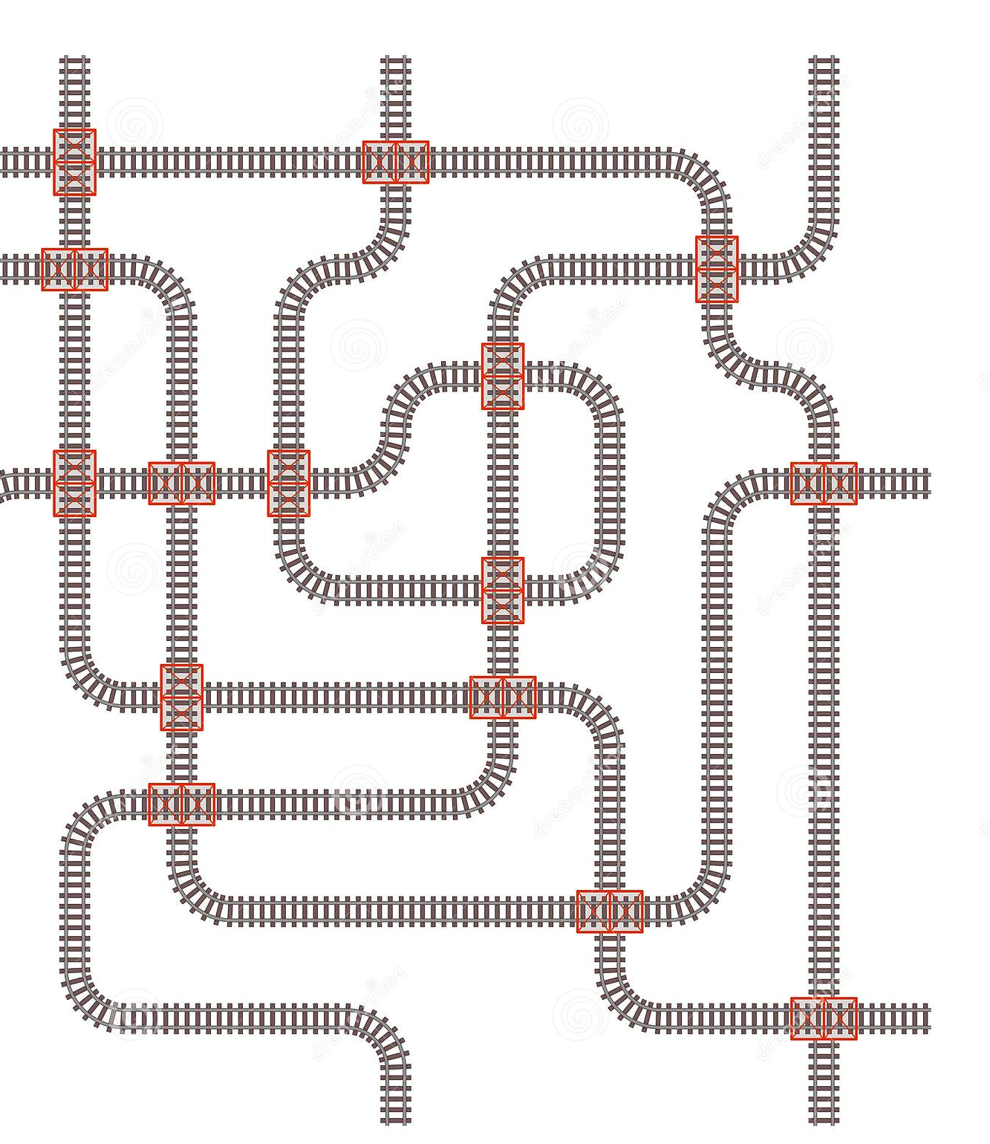
Routing to the Final Destination
Notes:
SUE:
WOW! That was a lot of information to take in. The train is running full steam ahead. <CLICK FOR TRAIN NOISE> We are en route to the final destination!
Next stop: How this might affect your Area?
<CLICK>

Slide 14
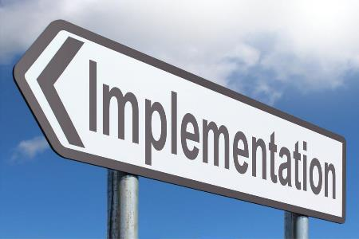
WSC Structure: Implementing Electronic Alateen Safety and Behavioral Requirements (EASBR)
Process to support electronic Al-Anon groups
Establish an EASBR
Notes:
SARAH:
Implementation for WSC Areas starts with establishing:
A process to support Al-Anon groups meeting electronically
Electronic Alateen Safety and Behavioral Requirements that meet the minimum requirements outlined by the 2003 Alateen Motion from the Board of Trustees, the policy for Alateen, and the Global Electronic Alateen Safety and Behavioral Requirements minimums
The World Service Office will continue to consult with local counsel to understand and implement any relevant international child welfare online participation laws in their Electronic Alateen Safety and Behavioral Requirements.
What about international structures? International structures that are recognized as a General Service Office of a national structure that choose to opt-in will agree to support the Global Electronic Alateen Safety and Behavioral Requirements. Alateen members who reside in countries supported by evolving structures or by a registered Al‑Anon Information Service Office are encouraged to participate in Electronic Alateen Groups in structures that meet the requirements to host electronic Alateen groups.
Isn’t that exciting news? With the establishment of Global Electronic Alateen Safety and Behavioral Requirements minimums, teens around the world will be able to attend Alateen meetings electronically across international borders. If an Alateen member attends a meeting outside the WSC Structure, they will need to adhere to any additional requirements of the hosting structure. An example of these requirements could be parental permission.
<CLICK>

Slide 15
WSC Structure: Laying the Tracks
Autonomy: Does your Area want to host electronic Alateen groups?
Gain groups’ approval to implement Global EASBR without modification.
Submit Area ASBR including Global EASBR to WSO.
Establish process for implementation, including:
Facilitating training for AMIAS-E
Ensuring AMIAS-E meet Global EASBR requirements
Reporting AMIAS- E status and validating and reporting all electronic Alateen groups registered to their Area have certified AMIAS-E Group Sponsors during the Annual Alateen Certification and Recertification Process
Notes:
SARAH:
The WSC Areas have the autonomy to decide if they would like to host electronic Alateen groups. Areas wishing to host electronic Alateen groups will need to gain their groups’ approval to implement the Global EASBR without modification. Once completed, Areas would submit their Area ASBR, including Global EASBR, to the WSO for certification. The certification will be reviewed
prior to registering Electronic Alateen Groups. Areas need to establish a process for implementing the Global EASBR. Areas will have the autonomy to define how they implement the process.
The Area process needs to include:
Facilitating training of AMIAS-E using additional training modules created by the WSO for EASBR implementation and certification.
Ensuring AMIAS-E who are sponsoring Electronic Alateen Groups meet Global EASBR requirements.
Reporting on AMIAS-E status during the Annual Alateen Certification or Recertification process.
Validating and reporting all Electronic Alateen Groups registered to their Area have certified AMIAS-E Group Sponsors during the Annual Alateen Certification or Recertification process.

Slide 16
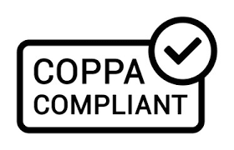
WSC Structures: Continuing the Journey
Global Electronic Alateen Safety and Behavioral Requirements are subject to evolving legislation, including the COPPA law.
Opting in?
Agree to implement new requirements as soon as enacted and notified.
Notes:
SARAH:
In order for the train to stay on track and not derail, it’s imperative the conductor receives clear direction from the signal person!
As the conductor of the Global Electronic Alateen Safety and Behavioral Requirements, the WSO will be watching for signals from WSC Structure lawmakers that relevant legislation has evolved. As previously mentioned, the Children’s Online Privacy Act (COPPA) or any other proposed bill or law may change. If these changes necessitate changes to the Global Electronic Alateen Safety and Behavioral Requirements, the WSO would notify the Areas and international structures to anticipate changes. At the same time, national structures would need to be listening for direction from their national governance bodies for relevant changes which might affect their own Electronic Alateen Safety and Behavioral Requirements. This is particularly important because teens will be able to cross international borders.
All national structures, including the WSC, will need to modify their Electronic Alateen Safety and Behavioral Requirements to implement and abide by new and updated laws at the time of enactment.
And so, the journey continues …
<CLICK>

Slide 17
International Structures: Modifications
General Service Offices or national structures
International structures can exceed global minimums
Alateens who attend global meetings must adhere to any additional requirements
Notes:
SARAH:
The Global Electronic Alateen Safety and Behavioral Requirements are very similar for the international structures. However, there are a few caveats and modifications to ensure structures have the flexibility to adhere to their laws.
International structures who wish to participate and host Alateen electronic groups will need to be registered as a General Service Office/National Structure because they register and support Al-Anon Family Groups.
A slight modification that’s different from the WSC Global EASBR is that international structures have the ability to exceed the minimum, because each country has different laws that govern the relationship with minors. The WSC Areas will adhere to the Global EASBR minimums as written, because the minimum is the most stringent of all WSC Areas.
Any Alateen member who chooses to apply to meetings outside of the WSC Structure would be required to meet any additional guidelines outlined by international structures

Slide 18
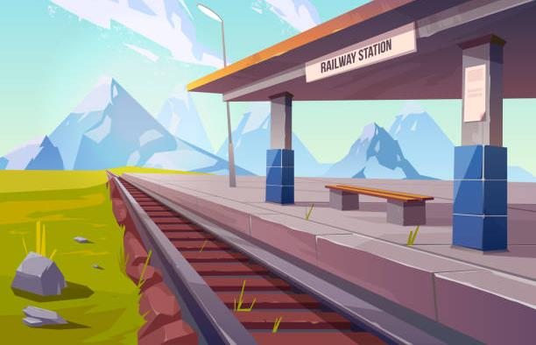
Questions: Scenic View
Notes:
SARAH:
Finally, we have reached the destination. Now that you have experienced a scenic view of Global Electronic Alateen Safety and Behavioral Requirements, let’s explore some of the specific questions you provided in advance. Today, we will answer questions that are relative to the conceptual process. Many of you sent questions about Alateen in general. We will read each question and provide the answer. Before we end this session, we will provide you with a link to two surveys in the Whova App. These are the same surveys we asked the international structures to complete. Please fill out the surveys prior to the next session for Alateen Feasibility.
Prepared Questions and Answer Session:
Before we close this session, let’s initiate both surveys in the Whova App.
Survey – Describe in one word how you are feeling about the proposed conceptual process for electronic Alateen groups.
Survey – Four-question feedback survey.
What potential challenges do you see with the conceptual process?
What benefits do you see with the conceptual process?
Do you see this as an opportunity to expand the reach of Alateen?
After hearing the presentation, do you think your Area would be able to support Electronic Alateen groups? Why or Why not?

Slide 19

Part Two: Feedback from International Structures
Notes:
SARAH:
Many of you may not realize that international structures are asked to adhere to the guidance in the Policy Manual even though they don’t vote on matters affecting policy. At the 2022 International Al-Anon General Services Meeting (IAGSM), our Executive Director, Vali, made a formal amends to the international structures for the WSC Structure not always seeking input from them before Policy is approved.
As a result, we facilitated the first-ever International Town Hall Meeting to invite international structures into the conversation. The goal of the meeting was to ensure all voices were heard, ensure the Conceptual Process made sense at a high level, and gather feedback about the process. This meeting was well-attended, with 92 participants from countries all over the world. We shared with the international structures that this was a very new process for the World Service Conference Structure and that they were actually receiving this information prior to the WSC members.
We respectfully requested that they honor the spiritual principle of confidentiality and keep the conversation within their respective AIS Committees and Boards of Trustees until we were able to present at our World Service Conference. Before we closed the Town Hall Meeting, we affirmed that the Town Hall was part of a bigger conversation and at this time no action should be taken.

Slide 20
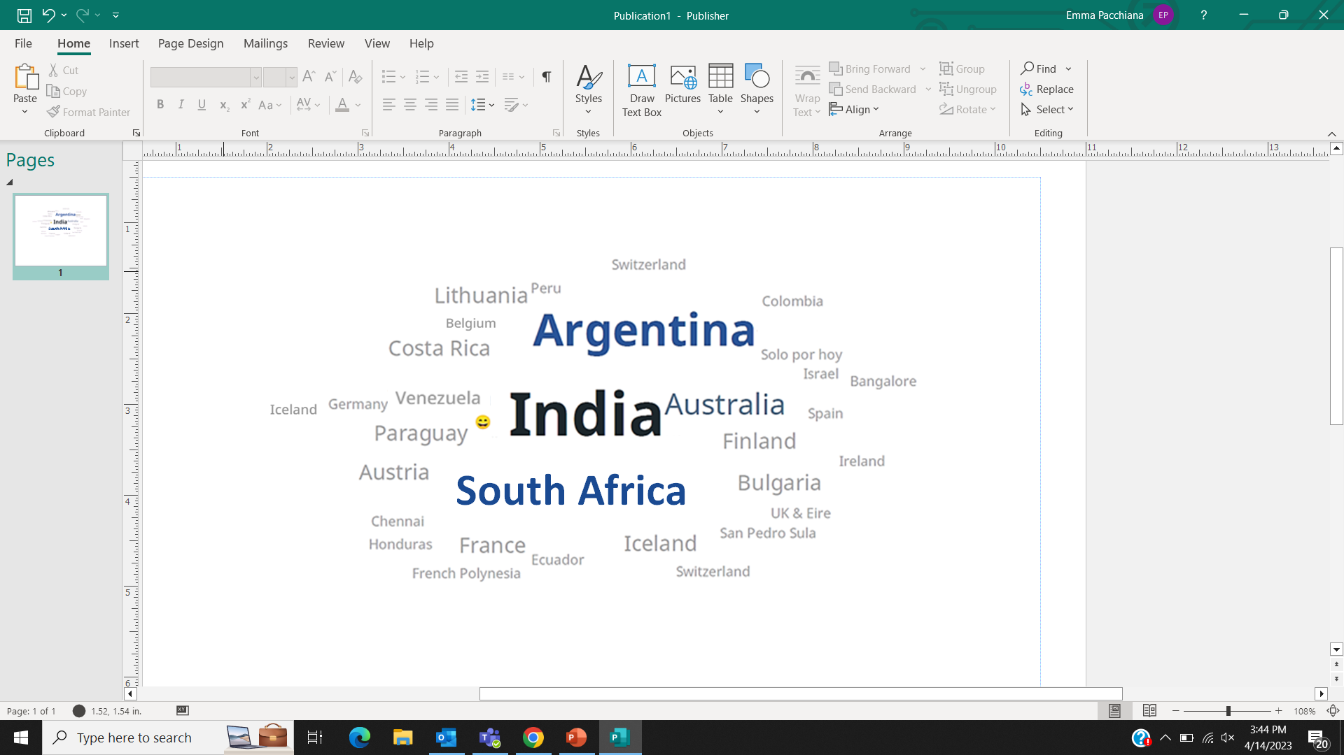
International Partners
Notes:
SUE:
More than 35 countries shared their feedback! This meant the meeting covered several time zones, with some participants logging in late at night or early—very early—in the morning. Simultaneous interpretation in French and Spanish, along with closed captioning translation available through the WebEx software, helped remove language barriers so all could participate in real time.

Slide 21
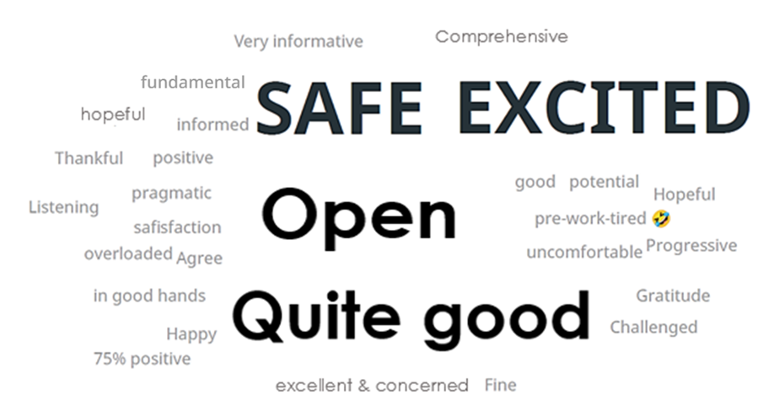
Feelings about proposed conceptual solution…
Notes:
SUE:
The meeting agenda was very similar to this presentation. We provided the conceptual process to the international structures in advance, as we did with the WSC, and asked them to prepare questions and send them to the World Service Office. At the town hall meeting we presented this PowerPoint presentation, then provided answers to all the questions received that were relevant to the conceptual process. Immediately following, we initiated the word cloud poll that you are now seeing on the screen. The prompt was: “Describe in one word how you are feeling about the proposed conceptual process.”

Slide 22

International Structures: Global EASBR Survey
What benefits do you see with the conceptual process?
What challenges do you see with the conceptual process?
Do you see this as an opportunity to expand the reach of Alateen?
After hearing the presentation, do you think your structure would be able to support electronic Alateen groups?
Notes:
SUE:
We asked the international structures to complete a brief survey about the proposed conceptual process. The following questions were on the survey:
What benefits do you see with the conceptual process?
What challenges do you see with the conceptual process?
Do you see this as an opportunity to expand the reach of Alateen?
After hearing the presentation, do you think your structure would be able to support electronic Alateen groups? Why or why not?

Slide 23
Survey Results: Benefits
Benefits of the Global EASBR
Sense of security
More accessible to teens urgently seeking help
Globally consistent requirements – safety across globe
Inclusion and participation of members where there is no structure
Structures can abide by the laws of their country
All structures have access to electronic Alateen groups
May “revitalize” Alateen
Support from WSC for electronic Alateen meetings globally
Notes:
SARAH
:
The survey results revealed the following benefits:
Heightened sense of security
Ability to help teens who are urgently seeking help.
Global consistent requirements – safety across the globe – support from the WSC for electronic Alateen meetings globally
Inclusion and participation for Alateen members where there is no structure to support Alateen meetings
Structures can abide by the law of their countries
All structures have access to Alateen
Revitalize Alateen

Slide 24
Survey Results: Challenges
Challenges of the Global EASBR
Getting Sponsors/AMIAS-E for electronic Alateen groups
Teens obtaining a photo ID
Structures need flexibility to ensure legal compliance
Anonymity of members
Pre-interview process – teens may not want to do it
Notes:
SARAH:
The survey results revealed the following challenges:
Getting Sponsors for electronic Alateen groups
Teens obtaining photo ID
Structures need flexibility to ensure legal compliance
How to ensure anonymity of members
Teens may not be interested in going through pre-interview process

Slide 25
Survey Results: Do you see this as an opportunity to expand the reach of Alateen?
Notes:
SUE:
After presenting all the information, we then asked those present if they found this conceptual process to be an opportunity to expand Alateen. Since the poll was only completed in English, 26 respondents replied, as indicated by this graph.
Total Respondents – 26
Yes – 19 – 73 percent
No – two – seven percent
Maybe – five – 20 percent
Some of the explanations provided by survey respondents were:
It’s a great opportunity to reach teens who cannot attend physical meetings because they do not have reliable transportation.
The Alateen age group is eager to connect globally, as social media demonstrates. This will create a global Alateen society.
Some structures may have difficulty meeting the minimum requirements.

Slide 26
Survey Results: Do you think your structure would be able to support electronic Alateen groups?
Notes:
SUE:
We then followed up with this question: Do you think your structure would be able to support electronic Alateen groups?
Total Respondents – 28
Yes – 18 – 64 percent
No – five – 18 percent
Maybe – five – 18 percent
Some of the explanations provided by survey respondents were:
Every structure that has grown with the program, practices the spiritual principles, and internalizes Al-Anon's purpose could support electronic Alateen groups. Like anything else, it would surely take some time and training to implement.
Some structures may have difficulty meeting the minimum legal requirements.
We are still very young and uncertain, but I believe that with the help of the Al-Anon world community this will become possible in the future.
Perhaps not – there are very few volunteers to serve as Group Sponsors. With additional checks, fewer will offer this service. Alateens and parents may be fearful of a loss of anonymity.
This will allow us to move forward and formally adopt electronic Alateen groups into our structures.

Slide 27
Next Steps
Evolve
Make recommended changes to EASBR based on feedback received
Ask
Ask BOT to define next steps
Communicate
Communicate with WSC members and international structures
Share
Share presentation with BOT at July 2023 Board Meeting
Review
Review feedback and create cohesive presentation reflecting broadest global reach
Notes:
SARAH:
After all this information, you may be wondering, “what are the next steps?”
The Project Team will review all the information we received from the International Town Hall Meeting along with what we learn today from you as representatives of the WSC Structure. The Project Team will prepare a presentation that includes recommended suggestions and amendments to the Electronic Alateen Safety and Behavioral Requirements. At the July Board meeting, we will share the presentation with the Board of Trustees and seek their guidance as to next steps in the process. Once we have clear direction, we will communicate with the WSC members and international structures about the next leg of the journey.

Slide 28
The journey continues…
Notes:
SARAH:
On the behalf of the Project Team, we appreciate you taking a journey with us through the Feasibility of Alateen Electronic Groups. The goal of this project was to make online platforms available for all Alateen members who wish to participate- while ensuring the safety of Alateen and Al-Anon Members Involved in Alateen Service. Exploring the feasibility of Alateen Electronic Groups has afforded us the opportunity to work with our international partners and WSC Areas to ensure we collectively agree on a solution that could be supported by members globally. When this project began in 2021, we couldn’t have projected that in a few short years we would be having a conversation about Alateen members having the possibility to attend electronic Alateen groups globally. But here we are in 2023, at the World Service Conference, asking for feedback about the feasibility of Alateen electronic groups. So, let’s continue the journey, stop at necessary checkpoints to ensure we are on track, and, ultimately, we will reach our final destination.
<CLICK for train noise>NEED TO INSERT
At this time, we are happy to field any questions you may have about the possibility of Alateen electronic meetings.

